Slide 1
Chapter 13
Signs of Storms

Slide 2
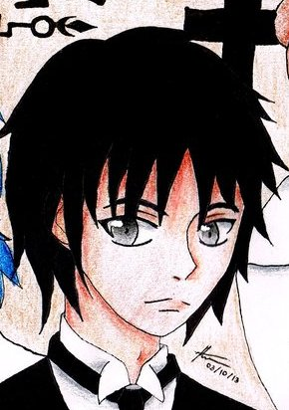
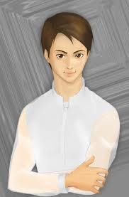
Crisostomo Ibarra and his servant at the cemetery upon arriving at San Diego,Ibarra was silent at all and made no replies at the servant.
My illness and my duties would not allow me to return.Capitan Tiago promised that he would see that a niche was constructed,but I planted some flowers on the grave and set up a cross carved by my own hands.
…
There behind that big cross,sir.
Was it here?..No, there!But the ground has been disturbed.
Yes,I remember that there was a stone behind it.The grave was rather short.The grave-digger was sick,so a farmer had to dig it.But let’s ask that man what has become of the cross.

Slide 3
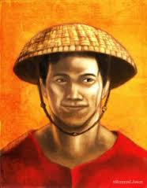
Ibarra’s servant talks to the grave digger.
Can you tell me which is the grave there that had a cross over it?
A big cross?
Yes!a big one.
A big cross tied up with rattan?
That’s it.Were there flowers,oleander and forget-me-nots.Tell us which is the grave and where the cross is?
Well.as for the cross,I burned it because the fat curate told me so.

Slide 4
Ibarra talks to the grave-digger upon hearing what he said.
Who is the fat curate?
The one that beats people with a big cane.
But the corpse is no longer there.
But at least you can tell us where the grave is.You must remember that.
I buried a woman in that place a week ago.It has been a year since you buried him but I dug the body up a month ago and should take it to the Chinese cemetery.But it was heavy and there was rain that night-
What are you saying?
Did you do that?
I didn’t bury him among the Chinamen,so I threw the body into the lake.
You are only a miserable slave!
All the trouble did men cause!The fat padre caned me for allowing it to be buried while I was sick,and this fellow almost tore my arm off for having dug it up.That’s what the Spaniards are.I’ll lose my job yet!

Slide 5
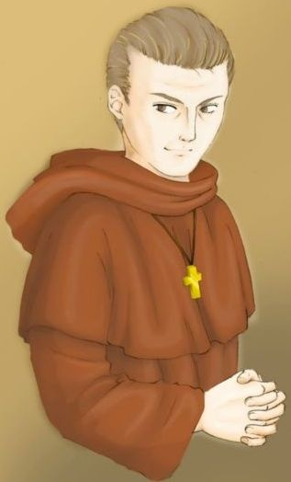
Ibbara walked out in thae cemetery with a far-away look, he meet Fray Salvi whom he mistake as Fray Damaso.
What did you do to my father?!
You are mistaken,I did nothing to your father.
You didn’t?
No,I assure you it was my predecessor,it was Padre Damaso!
Ah!

Slide 6
Chapter 14
Tasio:Lunatic or Sage

Slide 7
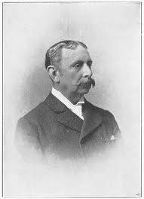
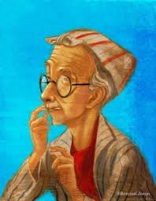
Near the church,he meet the gobernadorcillo.
You seem to be merry?
Yes I am senor capitan.I’m merry because I hope for something.
The storm!
Ah. What do you hope for?
That’s not a bad idea.But I hope for something better.
Some thunderbolts that will kill people and burn down houses.
The storm?Are you thinking of taking a bath?
We all deserve it!You senor,have there a bundle of tapers that came from some Chinese shop,yet this now makes the tenth year that I have been proposing to each new occupant of your office the purchase of lightning-rods.Everyone laugh at me,and buys bombs and rockets and pay for the ringing bells.Even you yourself,on the day after I made my proposition,ordered from the Chinese founders a bell in honor of St. Barbara,when science show that it is dangerous to ring the bells during a storm.Explain to me why in the year ‘70,when lightning struck in Binan,it hit the very church tower and destroyed the clock and altar.What was the bell of St. Barbara doing then?
What then?
Why don’t you ask for the deluge at once?
Jesus Maria y Jose!Holy St. Barbara!

Slide 8
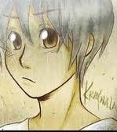
After talking to the scared Gobernadorcillo,Tasio noticed the two boys Crispin and Basilio.
Won’t you came with me boys?You mother has prepared a supper for you fit for a curate.
The senor sacristan will not let us leave until 8 o’clock sir.I expect to get my pay to give it to our mother.
Ah!And where are you going now?
To the belfry sir,to ring the knell for the souls.
Then take care!Don’t go near the bells during the storm.

Slide 9
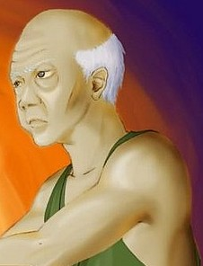
On the way home of Tasio.:
What are you reading there?
Won’t you come in?
The author must be a very clever person.
The torments suffered by the blessed souls in purgatory.
Yes,I saw him as he alighted from his carriage.
Did you meet in the son of the deceased Don Rafael, who had just return from Europe?
I always prefer to honor a good man in life rather than to worship him after his death.
They say he went to look for his father’s grave.It must have been a terrible blow.
But madam,I belive that each one should recieve the reward of punishment for his own deeds.
Well?
Did you order a mass for your wife as I advised you yesterday?
No.

Slide 10
Tasio continued to chat with the Don while going in of the house.
They say that until 10 o’clock tomorrow the souls will wander at liberty,awaiting the prayers of the living,and that during these days one mass is equivalent to 5 on other days of the year,or even to six,as the curate said this morning.
What a pity!
Does that mean that we have period without paying,we should take advantage of?
I don’t believe in purgatory,though I know a history in one of them.
But I do suppose that you believe in damnation?
I don’t know madam,what God will do with me.
What thought is that?

Slide 11
Chapter 15 The Sacristans

Slide 12
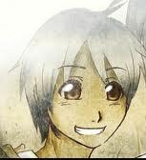
Crispin and Basilio at the Church of San Diego:
Oh,if I were only at home now with mother,There I shouldn’t be afraid.There no one would say that I stole,Moter wouldn’t allow it.If she knew that they whip me-
Pull on the rope,Crispin,pull!
…….
Are we always going to leave this way,brother?I’d like to get sick at home tomorrow,I’d like to fall into a long sickness so that mother might take care of me and not let me come back to the convento.And you too,brother,you must get sick with me.
No,we should all die:mother of grief and we of hunger.
Two pesos.They’re find me twice.
How much will you get this month?
Are you crazy, Crispin?Mother wouldn’t have anything to eat.The senior sacristan says that you’ve stolen 2 gold pieces,and they’re worth 32 pesos.
Then pay what they say I’ve stolen,so that they won’t call us thieves.Pay it,brother!

Slide 13
6 hands and 2 fingers over and each finger a peso!And each peso,how many cuartos?
A hundred And sixty.
A hundred and sixty cuartos?Goodness!And how many are a hundred and sixty?
Thirty hands.
32 hands,6 hands and 2 fingers over and each finger a cuarto-goodness,what a lot of cuartos!I could hardly count them in 3 days-Now I’m sorry that I didn’t steal!
Crispin!
What I’m afraid of is that mother will scold you when she knows about it.
Don’t get angry.The curate said he will beat me to death if the money would not be returned.Anyhow if I died,mother would atleast have clothes.Oh!if only I had stolen it.

Slide 14
Do you think so?I had only 1 cuarto,which was given to me last easter,but the curate took that away from me yesterday.I never saw a prettier cuarto!No.mother won’t believe it.
If the curate says so-
Crispin,don’t cry!Mother won’t believe it-don’t cry!Old Tasio told us that a fine supper is waiting for us
Then go home alone!Tell mother that I’m sick.I don’t want to go.
A fine supper!And I haven’t eaten for a long time.They won’t give me anything to eat until the 2 gold appear.If mother believes it,tell her that the senior sacristan is a liar but that the curate believes him and that all of them are liars,that they say that were thieves because our father is a vagabond who-

Slide 15
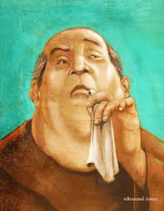
The sacristan punishes Crispin for Basilio did not ring the bell on time.Basilio stood speechless as he listen to her brother’s heartrending cries that died away in the distance.
On you Basilio,I impose a fine of two reals for not ringing the bells in time.You,crispin,must stay tonight,until what you stole reappears.
But we already have permission-mother expects us at eight o’clock.
But,sir,after 9 o’clock no one is allowed to be out and our house is far from here.
Neither shall you go home at eight,you’ll stay until then.
Are you trying to give me orders
Oh sir,it’s been a week noew since weve seen our mother.

Slide 16
Chapter 16 Sisa

Slide 17
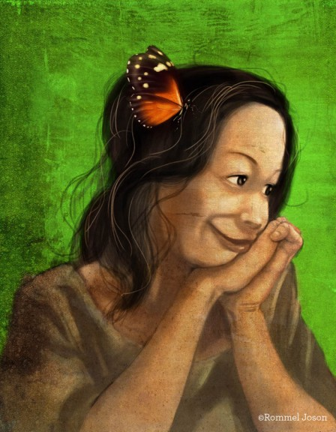
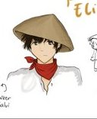
Sisa prepared a suffer for Crispin and Basilio but her husband came and ate all what she prepared.Her husband asks for the two boys and that for Sisa was better than eating.
Don’t you want to see them?Old Tasio told me they would be a little late.Crispin knows now how to read and perhaps Basilio will bring his wages.
In that case,keep a peso for me.
Mother,open the door!Open,mother!

