Slide 1
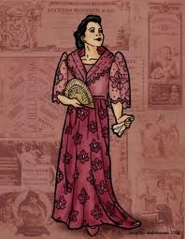
CHAPTER 39
DONYA CONSOLACION

Slide 2
Boy, tell her in tagalog to sing! She doesn’t understand me, She doesn’t understand Spanish!

Slide 3
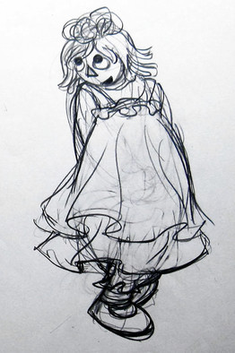
“The withered and faded flower which during the day flaunted her finery, seeking applause and full of vanity, at eventide, repentant and disenchanted, makes an effort to raise her drooping petals to the sky, seeking a little shade to hide herself and die without the mocking of the light that saw her in her splendor, without seeing the vanity of her pride, begging also that a little dew should weep upon her. The nightbiird leaves his solitary retreat, the hollow of an ancient trunk, and disturb the sad loneliness of the open places—”

Slide 4
No, don't sing!
(in tagalog)
Don’t sing! Those verses hurt me.

Slide 5
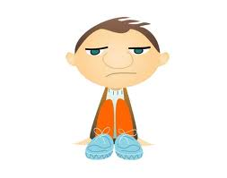
Aba! She talks tagalog!

Slide 6
Dance! Dance! Dance!

Slide 7
But Sisa did not move.
After a few minutes, sisa is start to dance.

Slide 8
Aha! Now you’re starting!
You’ve got to dance, you Indian.
Dance, damn you, dance! Evil to the mother who bore you! (crying) dance, or I’ll flog you to death!

Slide 9
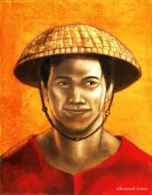
Stop!
What’s the matter with you? You haven’t even wished me good evening.”

Slide 10
Boy, take this woman away and tell Marta to get her some other clothes and attend to her. You give her something to eat and a good bed. Take care that she isn’t ill-treated! Tomorrow she’ll be taken to Senor Ibarra’s house.”

Slide 11
You’re tempting me to kill you!
What’s the matter with you?

Slide 12
What’s the matter with me! Didn’t you write this letter to the alcalde saying that I’m bribed to permit gambling, huh? I don’t know why I don’t beat you to death.”
“Let’s see you! Let’s see you try it if you dare! The one who beats me to death has got to be more of a man than you are!”
“Coward!” you’re afraid to come near me!

Slide 13
“Accursed be your offspring, you sow! Open, open or I'll break your head!”
Don’t come in, don’t come in! “if you show yourself, I’ll shoot you.”
“Go out into the street and cool off your head!”
I swear that if I catch you, even God won’t save you, you old sow!

Slide 14
Yes, now you can say what you like. You didn’t want me to go o mass! You didn’t let me attend to my religious duties!”
“have you really gone out or are you still there, old goat?
Boy, has your master gone out?

Slide 15
“Yes, senora, he’s gone out.”

Slide 16
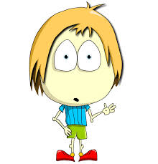
I? in any case whole town will! She asked me if he had gone out, not if he had come back!
You’ll pay for that.

Slide 17
CHAPTER 40
RIGHT AND MIGHT

Slide 18
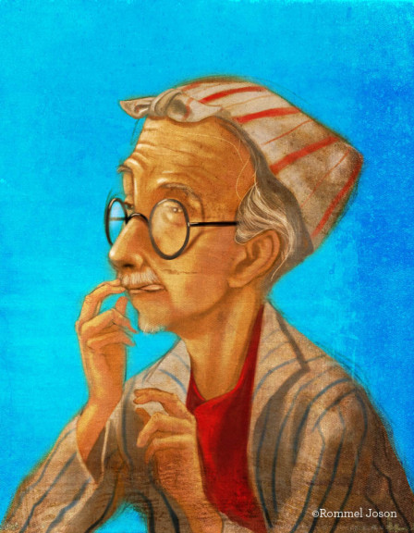
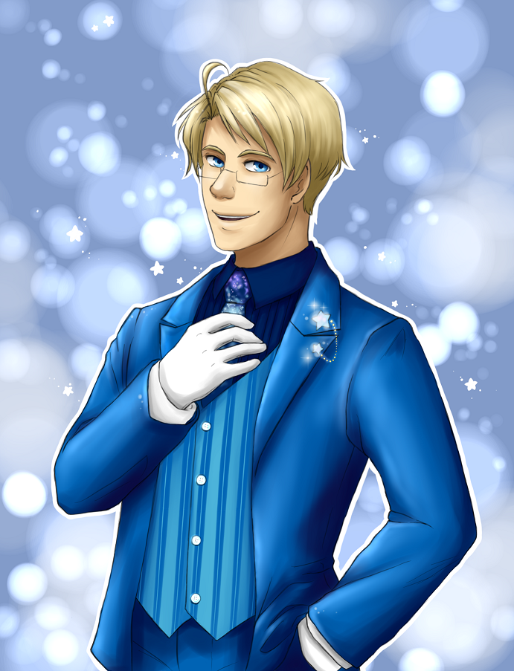
What can I do? The alcalde was unwilling to accept my resignation.
Don’t you feel strong enough to attend to your duties? He asked me.
How did you answer him?

Slide 19
Senior Alcalde, I answered, the strength of a teniente-mayor, how ever insignificant it may be, is like all other autority it emanates from higher spheres. The king himself recieves his strength from the people and the people theirs from God, that is exactly what I lack, senior alcalde. But he did not care to listen to me, telling me that we would talk about it after the fiesta.
Then may God help you!

Slide 20
Thanks, no! for dreams and nonsense I am sufficient unto myself.
don't you want to see the show?

Slide 21
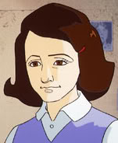
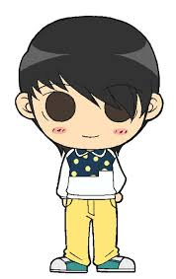
No, little friend, I had to go with the captain-general.
Did you see the fireworks?

Slide 22
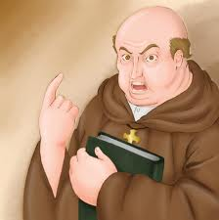
I’m sorry that I can’t please you revenge, but Senior Ibarra is one of the heaviest contributors and has a right to be here as long as he doesn’t disturb the peace.
But isn’t it disturbing the peace to scandalize good Christians? It’s letting a wolf enter the fold. You will answer for this to God and the authorities!

Slide 23
But it’s giving opportunity for danger, and he who loves danger perishes in it.
I don’t see any danger, padre. The alcalde and the captain-general, my superior officers, have been talking with him all the afternoon and it’s not for me to teach them a lesson.

Slide 24
If you don’t put him out of here, well leave.
I'm very sorry, but I cant put any one out of here.

Slide 25
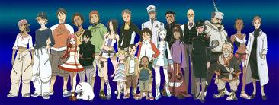
Were with you, don’t take any notice of them.
Whom do you mean by them?
Those who’ve just left to avoid contract with you.
Left to avoid contract with me?

Slide 26
Yes, they say that you’re ex-communicated.
Ex-communicated?
But it is possible?!
Are we still in the dark ages? S0—

Slide 27
Excuse me, ive forgotten an engagement. Ill be back to see you home.
Stay! Yeyeng is going to dance la calandria. She dances divinely.
I cant, little friend, but I’ll be back.

Slide 28
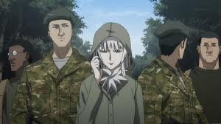
Stop!
Why?

Slide 29
Tell the alferez that we have permission from the alcalde that against such permission no one in the town has any authority., not even the gobernadorcillo himself, and he is my only superior.
Because the alferez and his wife have been fighting and cant sleep.
Well, the show must stop!

Slide 30
Take them to the town hall! (cried)
Take care that they don’t get away!

Slide 31
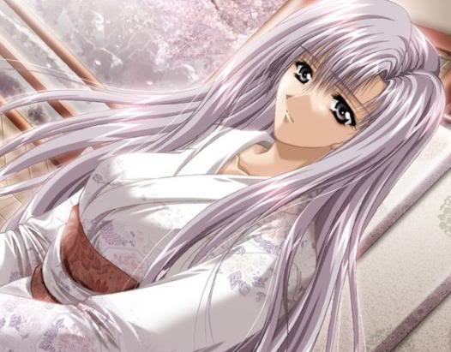
That’s what they’re good for!
To disturb the town! They don’t chase any but honest folks! Out yonder are the tulisanes and gamblers. Let’s set fire to the barracks!

Slide 32
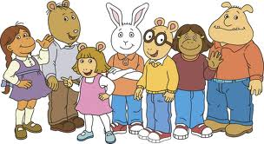
“Don’t disturb the peace!”
“Tomorrow well ask for an accounting and well get justice. Ill answer for it that we get justice!”
“No!” they did the same thing in kalamba, the same promise was made, but the alcalde did nothing. Well take the law into our own hands! To the barracks!

Slide 33
Senior Ibarra, as a favor! Restrain them while I get some cuadrilleros.
What can I do?

Slide 34
“For God’s sake do something, if you can! I cant do anything.”

